Slide 1
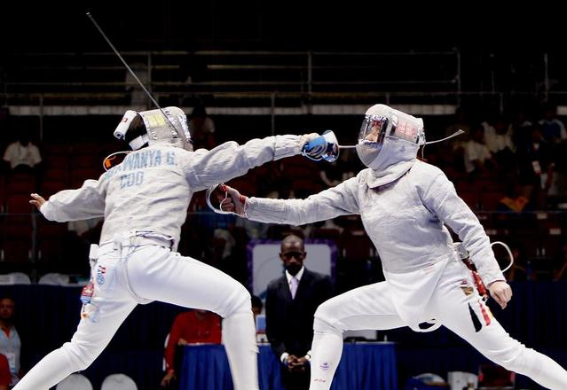
Sabre Death Match
Khoi Tran
More action, less rules

Slide 2
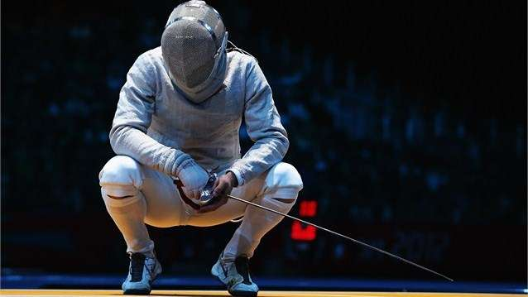
What is Sabre Death Match?
Summary: Replaces the old Olympic fencing rules with a new health point based system.
Old Rules: one touch, score is given based on a variety of rules (right of way), and fencers restart at starting positions –slow and repetitive.
New Rules: the fight continues until either fencer delivers enough damage to the other to deplete his/her health to zero –fast and continuous gameplay.

Slide 3
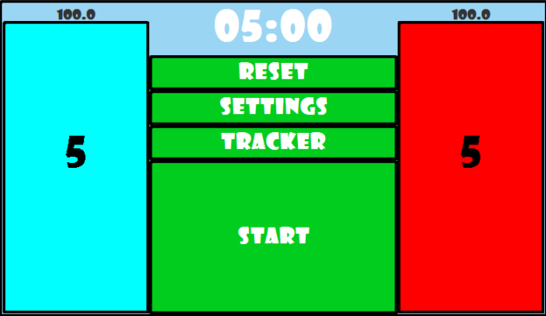

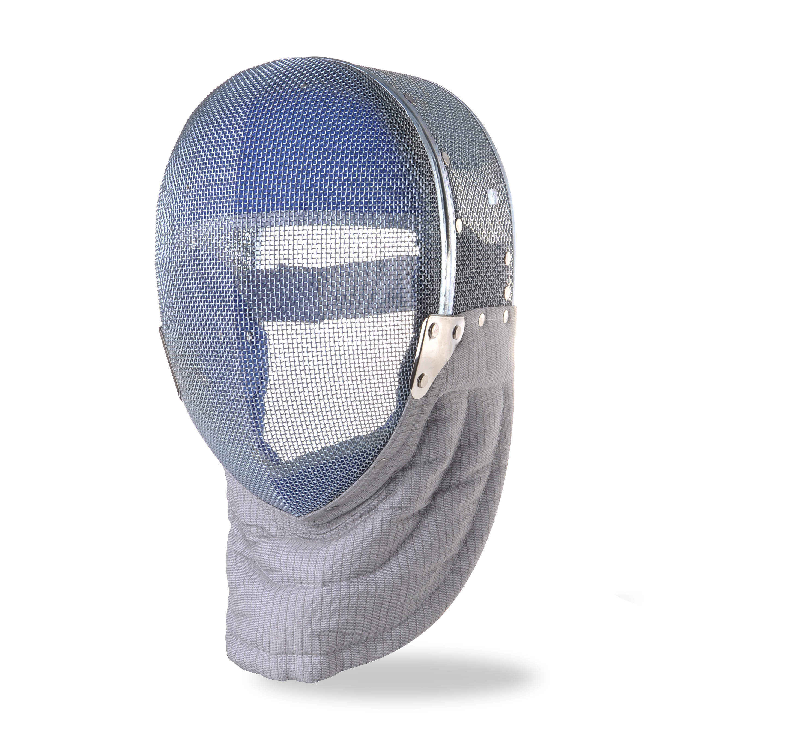
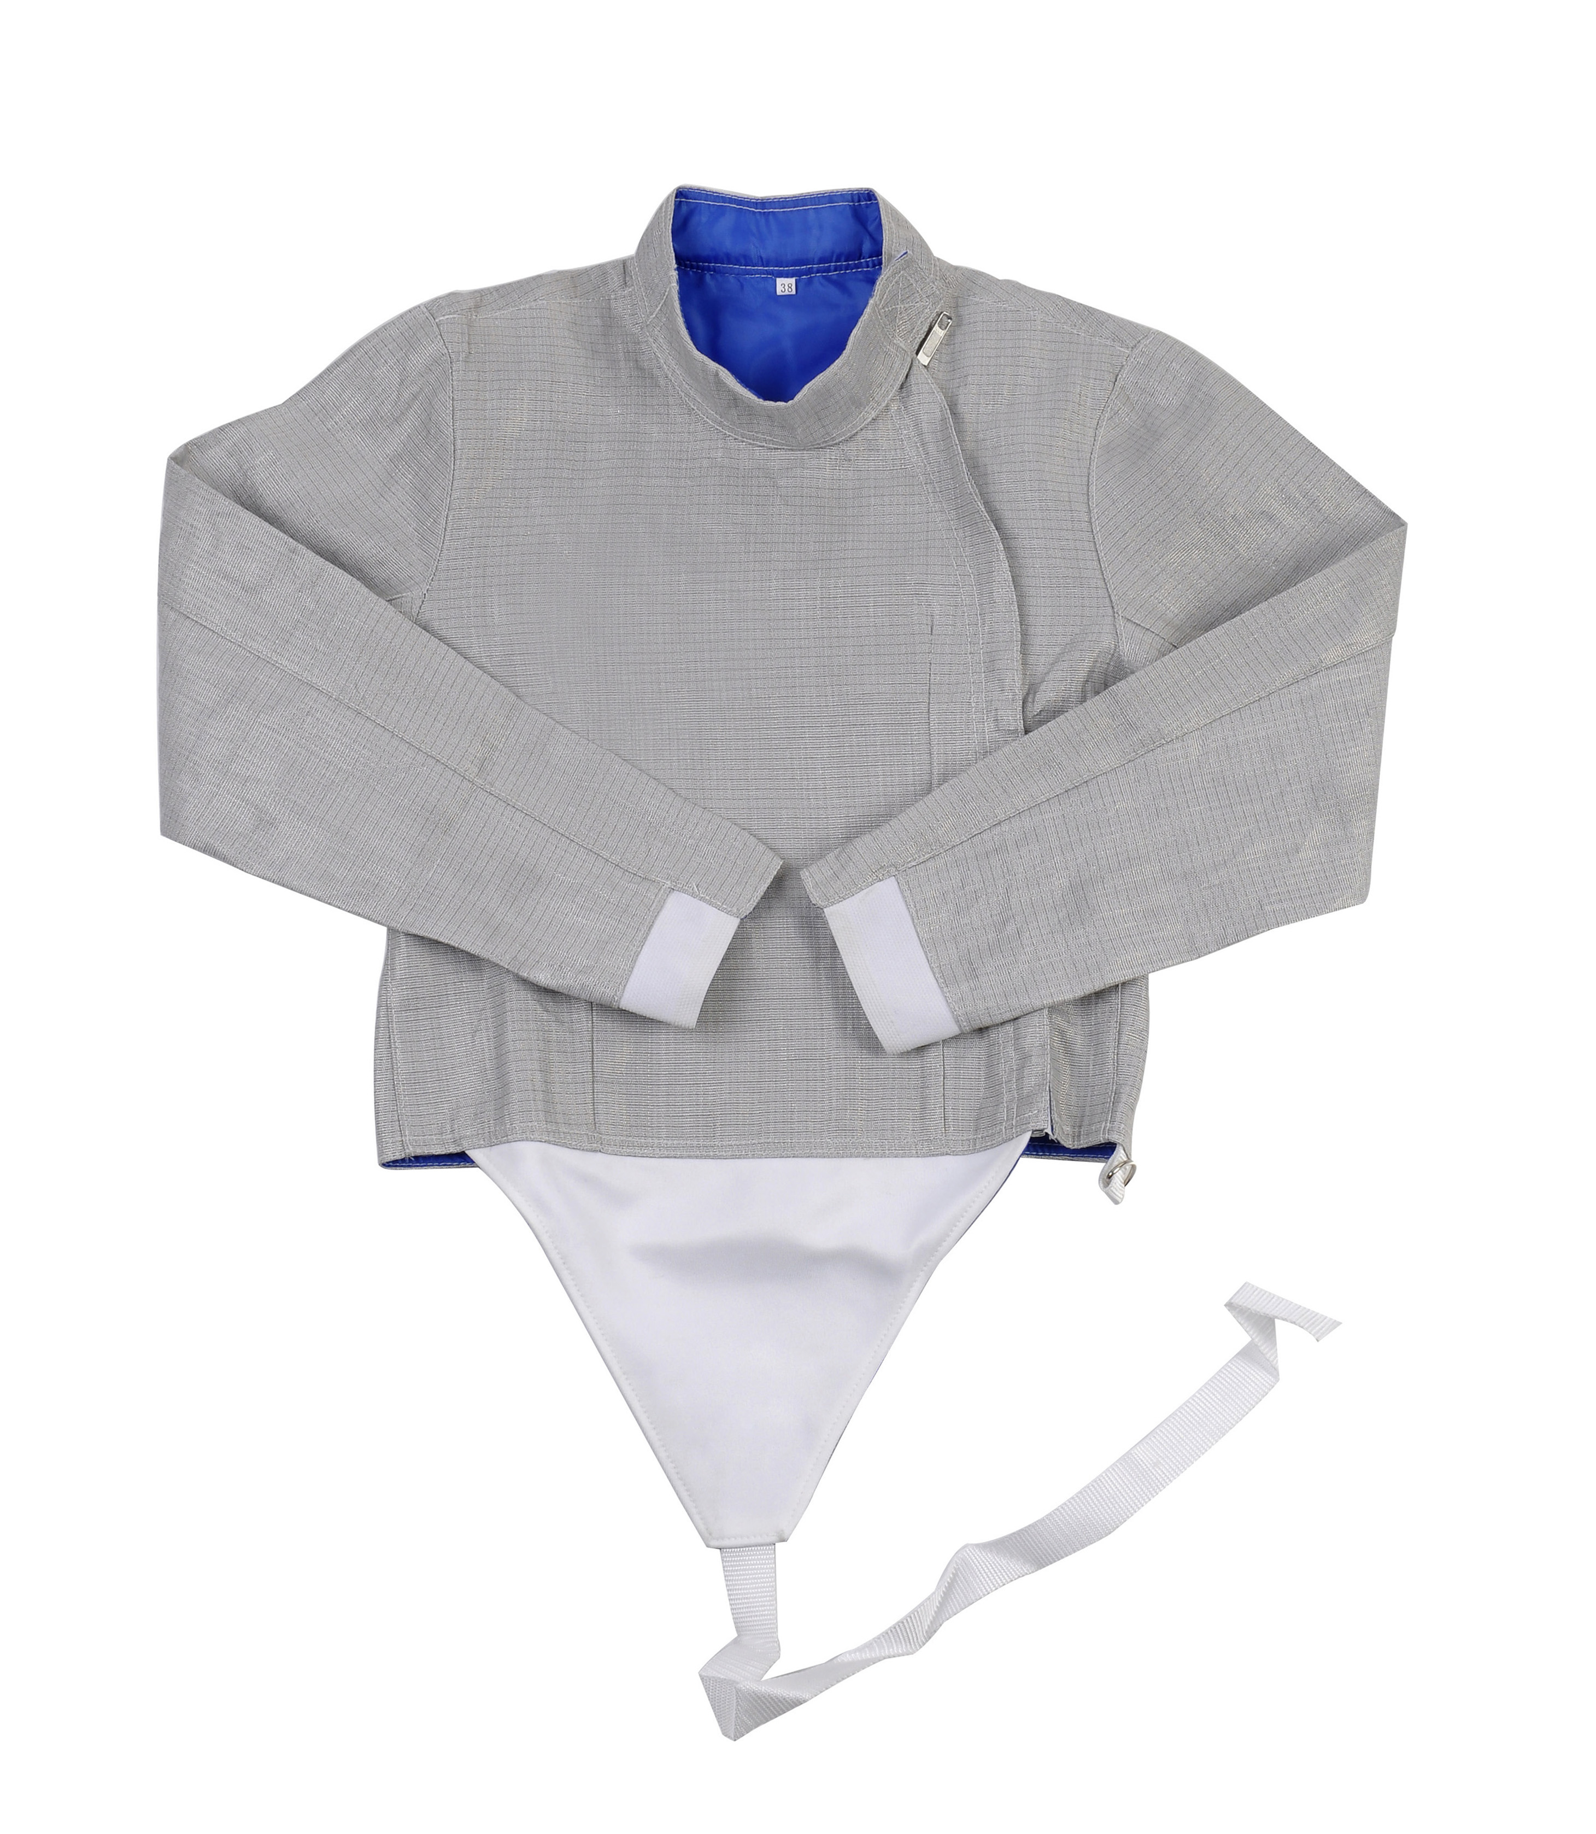
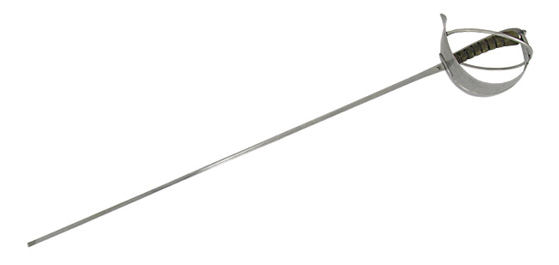
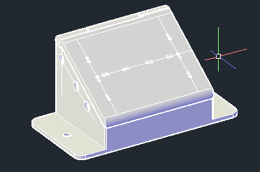
Sabre Death Match System

Slide 4
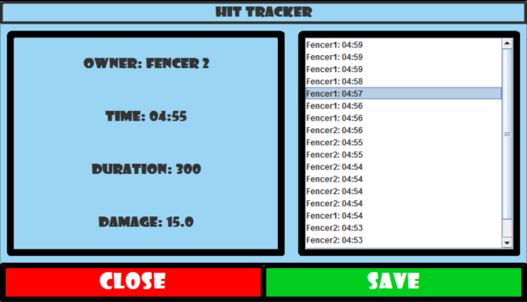

Program Interface

Slide 5
Interface Details
Manages:
Bout time limit
Fencer’s Health Bars
Fencer’s Lives/Stocks
Records Fencer’s Hit and Damage Calculations

